Slide 1

Table Tennis Shot Classification
DL PROJECT –
Classification of correct vs. incorrect table tennis shots

Slide 2


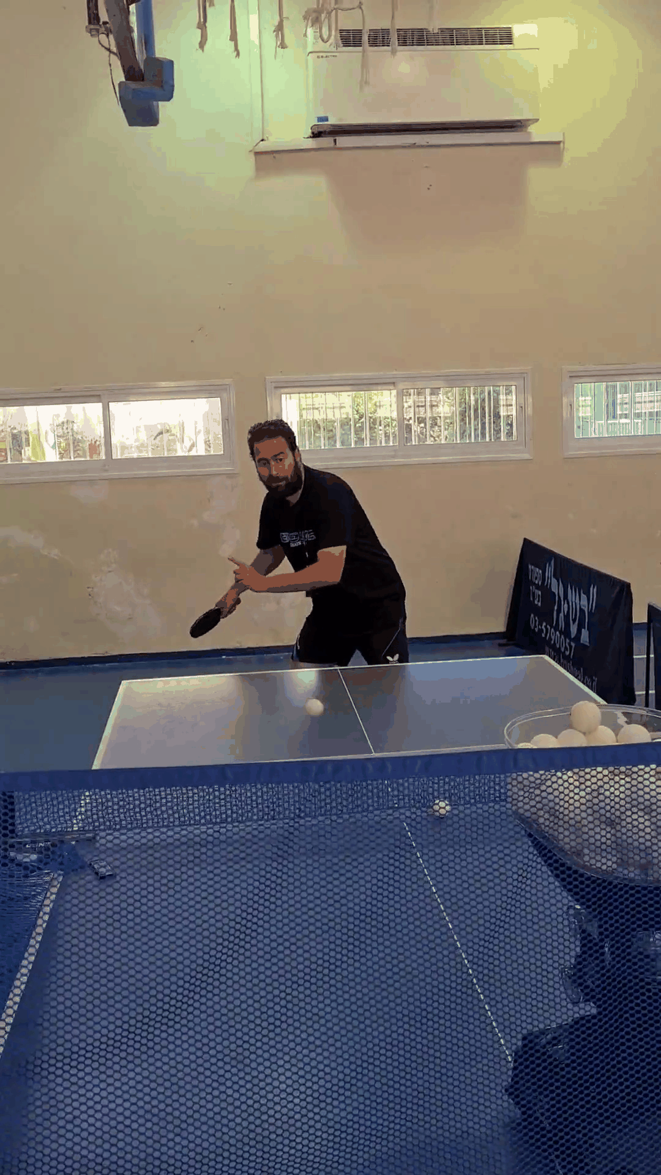
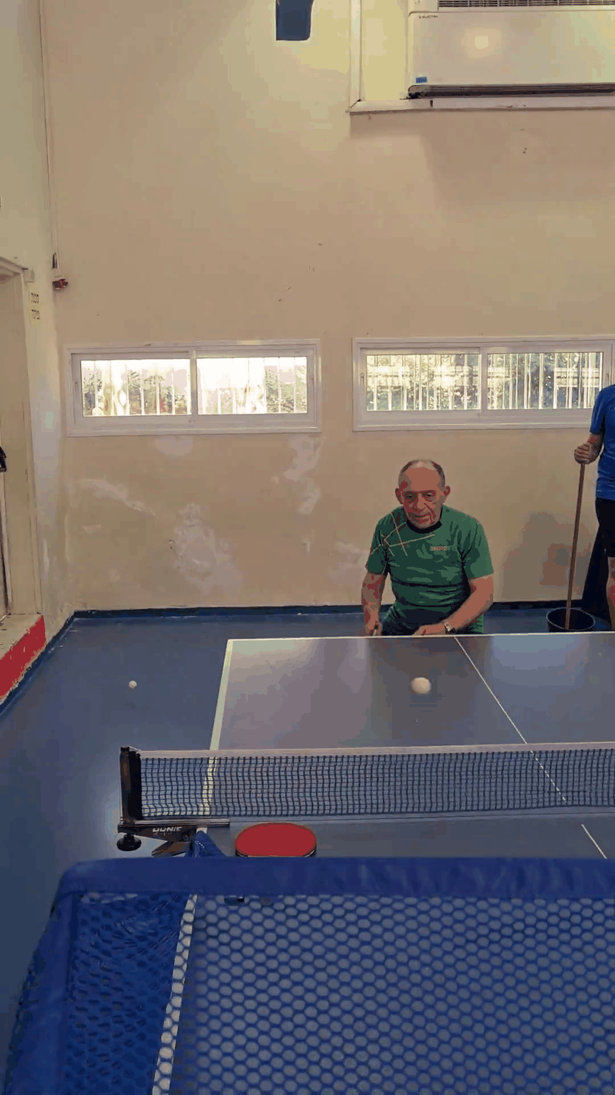
Goals
Main goal:
The main goal of this project is to classify and distinguish between technically correct table tennis shot to one that is not.
Application:
A real time mobile application used to improve player skill during practice.
Notes:
App might extract good and bad shots – so a player can learn from his mistakes

Slide 3
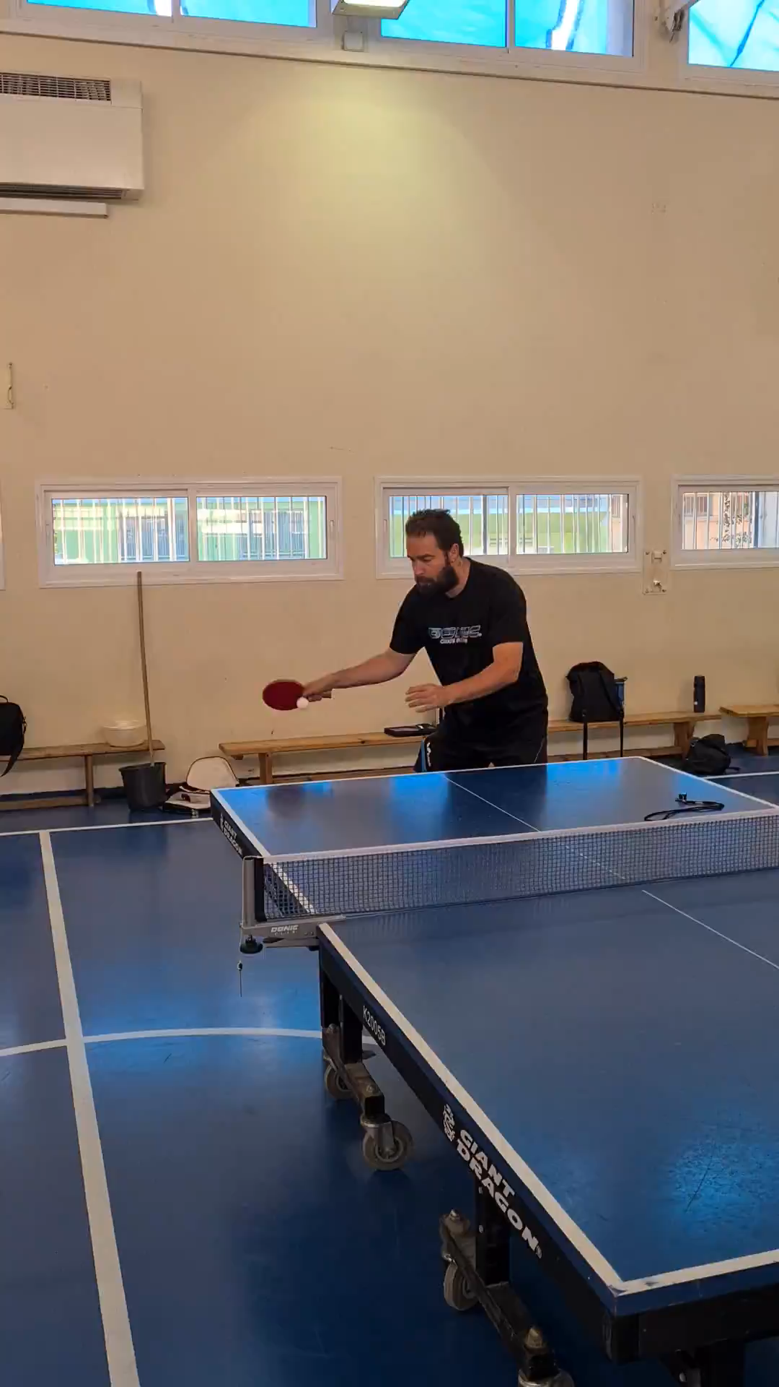
Data
Raw data consists of table tennis practice videos of several players in our local club. (ages of 15-60)
30 fps
A practice video contains a single player training on a specific shot repetitively
some parts of a video can contain “garbage” such as player picking up the ball, leaving the table to get it etc.
Shots were extracted from each video and were labeled manually by us
Extraction will be explained next slides
We collected 2 types of shots:
Forehand contra (push) - 2301 shots, 162 good shots
Forehand top spin - 1371 shots, 268 good ones
Each shot is on average 15 frames
Notes:
Videos were collected using a phone camera (galaxy s20)
Very small data set!
On the right video is a forehand contra example

Slide 4
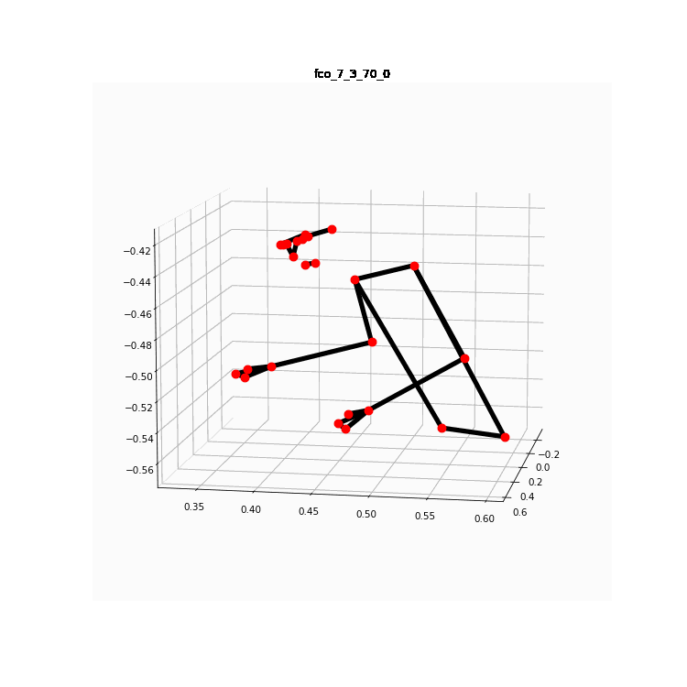
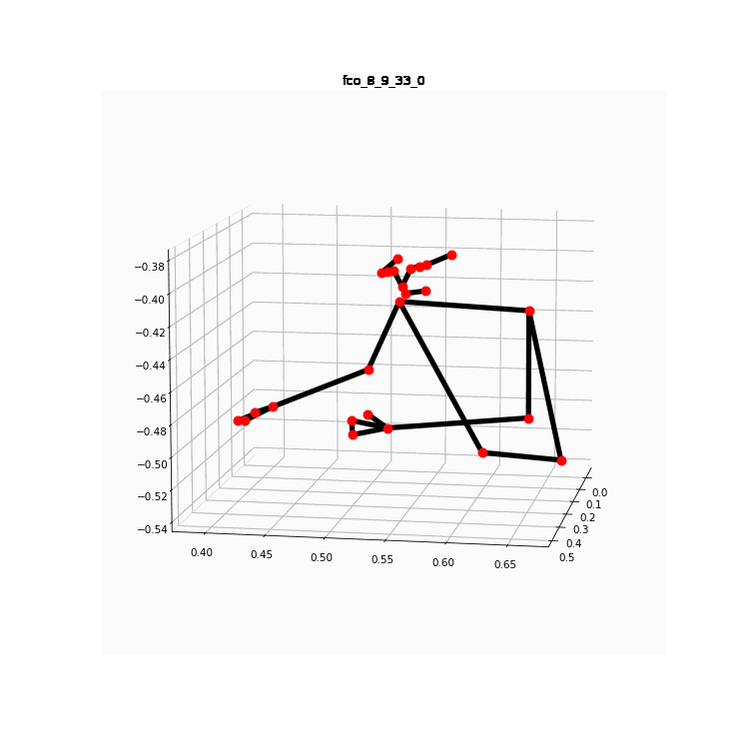
Architecture – high level
Video
Shot extractor
DL model
[
,
…]
,
predictions
[1,0,…]

Slide 5
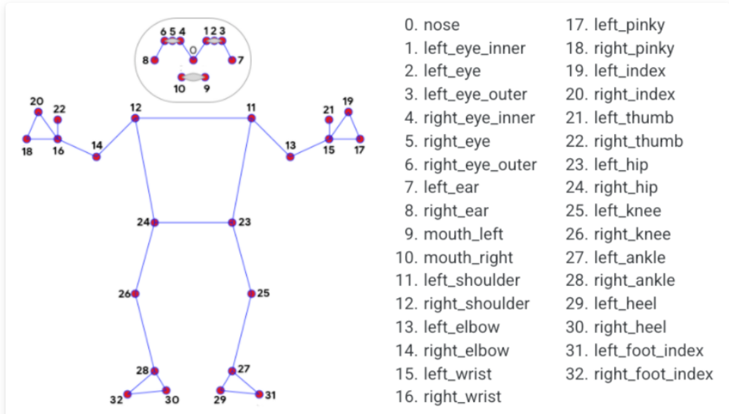
Architecture – Shot extractor
Media pipe pose
The shot extractor is a preprocess component that extract shots from a video
The Extractor uses Google's Media pipe pose – each frame is converted to landmarks
Media-Pipe Pose is a ML solution for high-fidelity body pose tracking, inferring 33 3D landmarks and background segmentation mask on the whole body from RGB video frames
We extract 25 landmarks per frame
Each landmark consist of 4 values - x, y, z and visibility, range from -1 to 1
A shot is a sequence of up to 50 frames
In case of a short shot, we pad with 0’s
Notes:
Media pipe - https://google.github.io/mediapipe/solutions/pose.html
Media-Pipe Pose is a ML solution for high-fidelity body pose tracking, inferring 33 3D landmarks and background segmentation mask on the whole body from RGB video frames

Slide 6
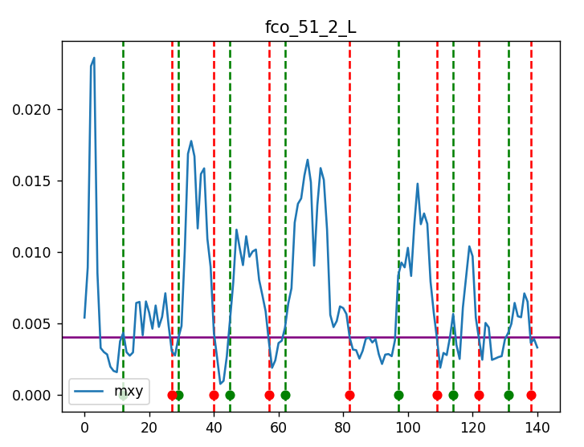
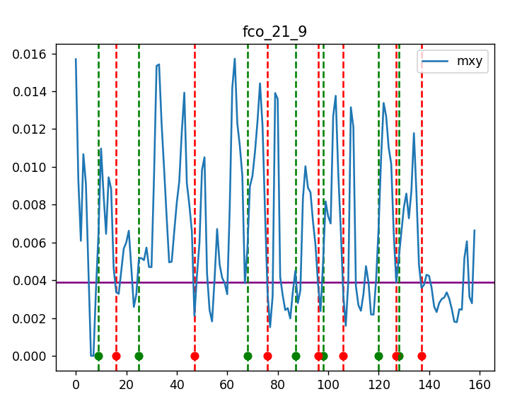
Architecture – Shot extractor
Extraction
We create a signal based on the landmarks (‘mxy’ - blue graph)
This signal describes the mobility of the right hand
In each frame we look at a window around it
There are 6 landmarks of the right hand, each has x and y coordinates
For each coordinate we average the diff between those values, in the window
E.g. diff of landmark 16’s x = [0.048, 0.05, 0.052] - > [0.01, 0.02] // ההפרשים
E.g. the avg is 0.015 // ממוצע ההפרשים
We average the right-hand landmark’s previous averages to a single value
6 averages for x and y per landmark
To determine if a shot has started or finished, we use a dynamic threshold (purple line)
The threshold is calculated each frame, just like the signal
Threshold = P * the avg of the signal so far
Each player has a very different “shot profile” depends on his speed, reaction time, technique etc.
Dynamic threshold enabled the extraction for different inputs
At the end we have a list of shots
Landmarks are saved during the process
Notes:
- For left hand player – we flip the image
- Empirically we chose P = 0.6
- Empirically we chose windows of size 3

Slide 7
Architecture – DL model
Network
The input from previous step is a shot of shape [50, 100]
50 frames (sequence), each frame has 100 values represent the 25 landmarks
Sequential model based on multi layers bidirectional LSTM with attention
Fully connected layer (hidden dimension -> 2 ) on top + log soft max
Training
Negative log likelihood loss
Adam optimizer
Step Lr scheduling
Early stopping

Slide 8
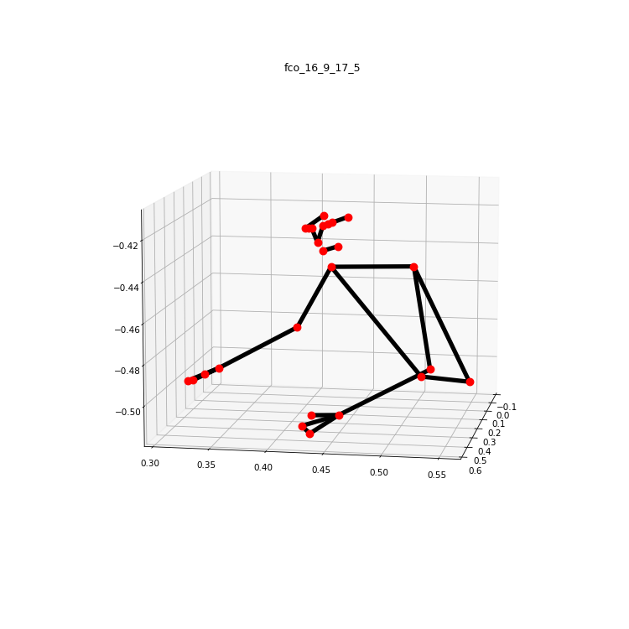
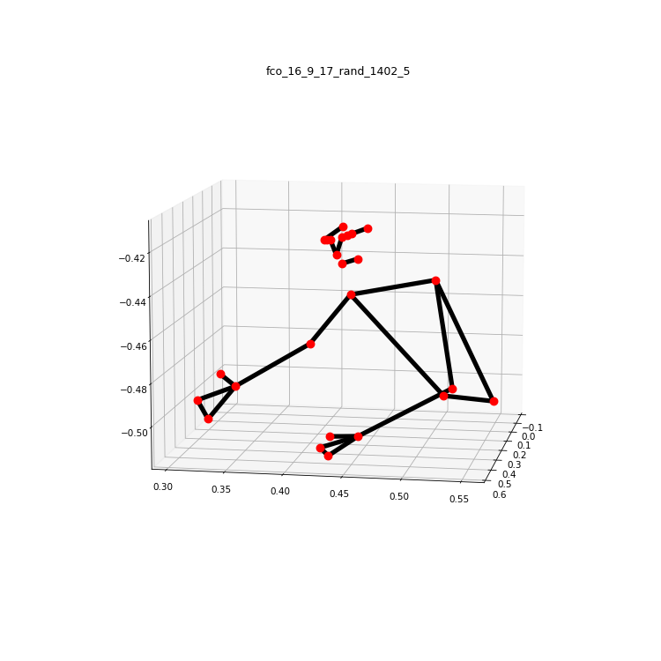
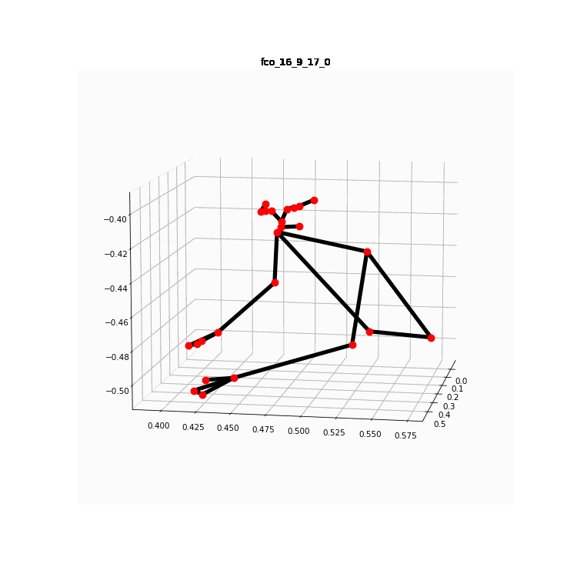
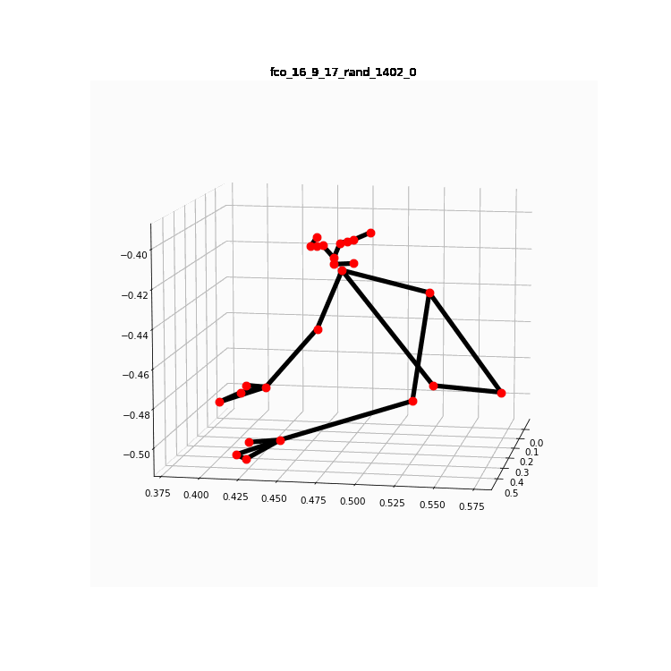
Data augmentation
Our data set is very small and not balanced
Test & validation set created in advance and are balanced
Train set is not balanced
We used data augmentation as part of our up-sampling technique
Pseudo code:
For each frame
For each right-hand landmark
X, y, z += Rand.Uniform[-0.01, 0.01]
Both frame, landmark and coordinates are chosen in random
Notes:
In the frame example above we can see the right shoulder is a bit more down – person is more leaning, and hand is a bit more open

Slide 9
Results & Examinations
Experiments made during the development:
fixed train, test & validation set
fixed hyper parameters ( 64 hidden dim, 3 layers etc.)
Simple settings – without up sampling and attention
simple up sampling – clone samples from minority class
Augmented up sampling
Augmented up sampling + adding the attention layer
Simple up sampling + attention layer
Notes:
During experiments we found best hyper params
Also tried some feature selection – remove some landmarks
Fts splitting: test + val – 75/75. Train – 118/953
fco splitting: test 50/50, val 32/32. Train – 80/2057

Slide 10
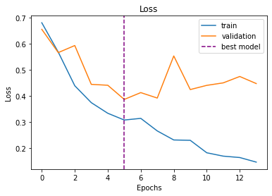
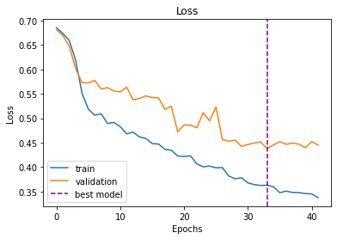
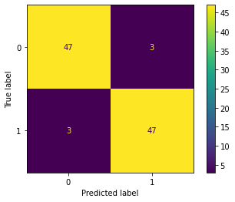
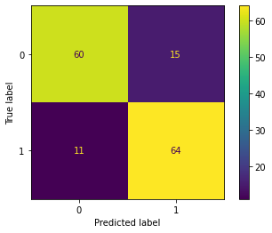
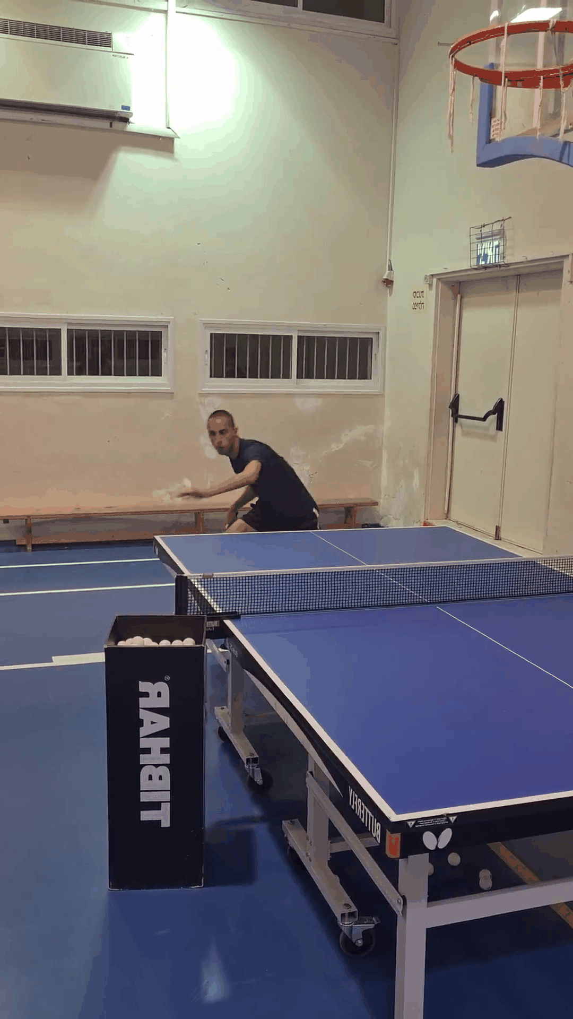
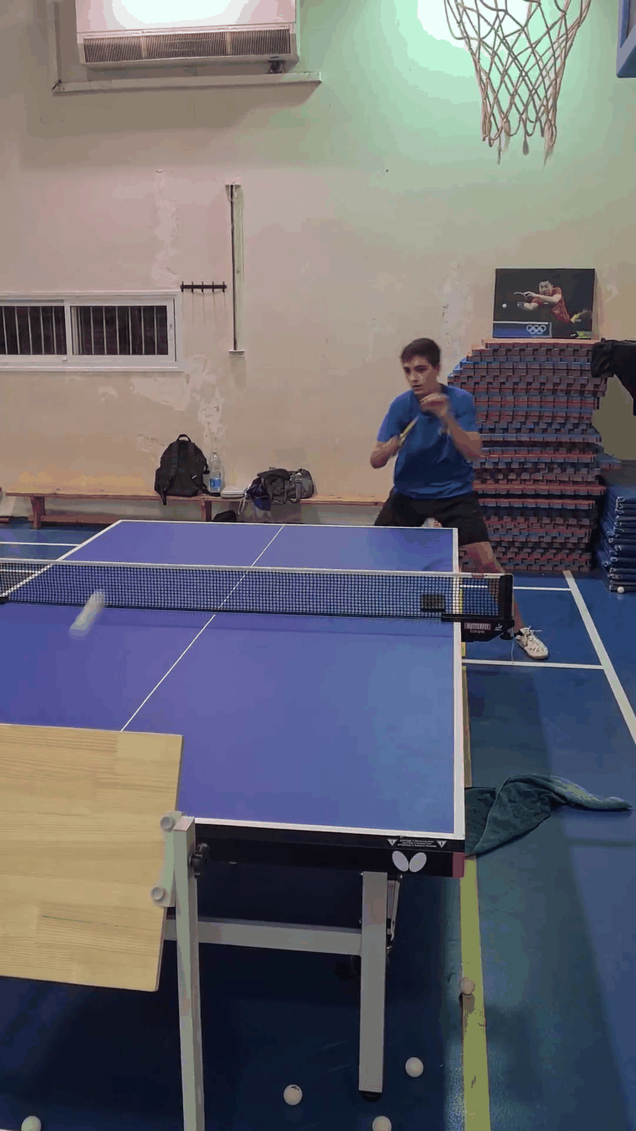
Results & Examinations
FTS:
FCO:
Notes:
Fts splitting: test + val – 75/75. Train – 118/953
fco splitting: test 50/50, val 32/32. Train – 80/2057
Fco is much easier, (shorter shot) to classify

